Slide 1

Exploratory data analysis
Austin Wilson

Slide 2

Import libraries
First create a new python script or jupyter notebook
import pandas as pd
import numpy as np
from sklearn import preprocessing
import matplotlib.pyplot as plt
plt.rc("font", size=14)
from sklearn.linear_model import LogisticRegression
from sklearn.model_selection import train_test_split
import seaborn as sns
sns.set(style="white")
sns.set(style="whitegrid", color_codes=True)
This Photo by Unknown Author is licensed under CC BY-SA

Slide 3
Data set
https://raw.githubusercontent.com/madmashup/targeted-marketing-predictive-engine/master/banking.csv
Store this file in the same directory as notebook
df = pd.read_csv(banking.csv')

Slide 4
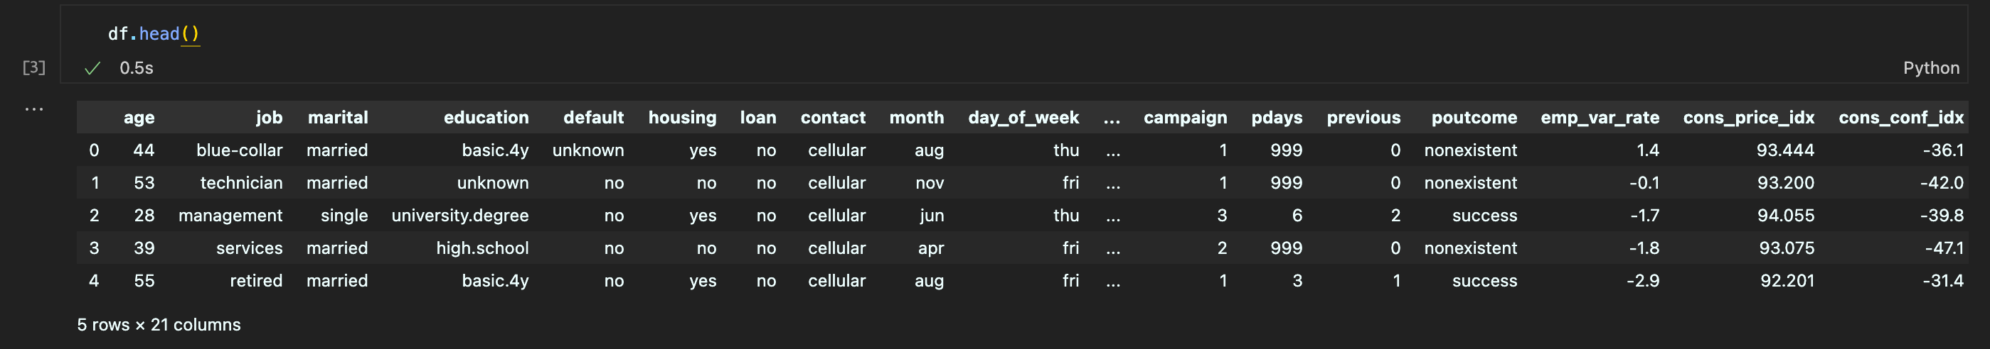
Explore first few entries
Print out the first n (13 in this case) entries
df.head(13)

Slide 5
Check out the columns
Every data frame has the attribute columns
df.columns # this command returns a list of the columns in the data frame
Index(['age', 'job', 'marital', 'education', 'default', 'housing', 'loan', 'contact', 'month', 'day_of_week', 'duration', 'campaign', 'pdays', 'previous', 'poutcome', 'emp_var_rate', 'cons_price_idx', 'cons_conf_idx', 'euribor3m', 'nr_employed', 'y'], dtype='object')

Slide 6
Select your columns of interest
There are various way to do this
You can explore them all!

Slide 7
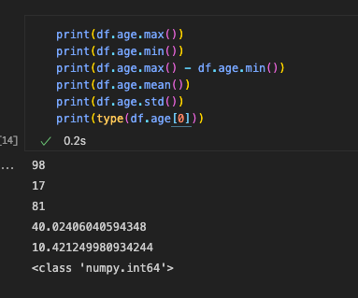
age
The first column is age which is numeric and has minimum value 17, maximum value 98, range 81, average 40.04, standard deviation 10.4, we can also see that the data type is stored as int64

Slide 8
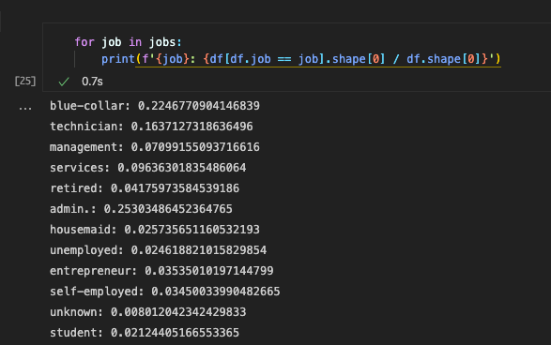
job
The second column is job which is categorical. The unique values of this column are blue-collar, technician, management services, retired, admin., housemaid, unemployed, entrepreneur, self-employed, unknown, student. Here is a way to print out the different categories and their counts as a percentage of the whole data set. This is important because if we don’t have enough records associated with a certain value we may not want to train a machine learning model on that attribute value.

Slide 9
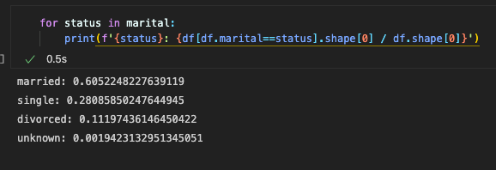
marital
In the same style here we see that most people are either married or single

Slide 10
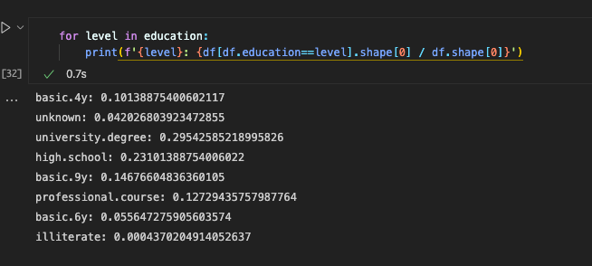
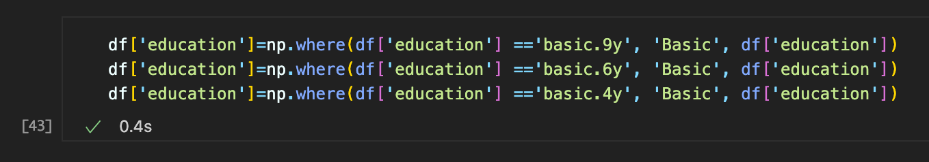
education
Now for education level there are several different categories basic.4y, unknown, university.degree, high.school, basic.9y, professional.course, basic.6y, illiterate
We can assume that basic.4y, basic.6y and basic.9y are all basic and relabel them accordingly

Slide 11
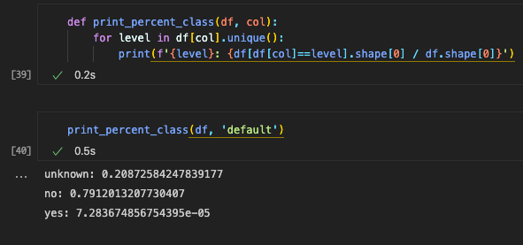
default
Customers who have defaulted (binary)

Slide 12
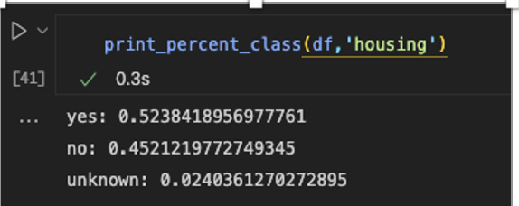
housing
House loan (binary)

Slide 13
y
This is the target variable
Has the customer subscribed to a term deposit

